Slide 1

GenieMart
Eduardo Herrera-Baraza
Jared Martinez-Sanchez
Lily Nguyen

Slide 2
Table of Contents
What is GenieMart?
Project definition
Our goal
Significance
How It Was Accomplished
Tech Stack
Team workload
Problems we faced
App Features/Use cases

Slide 3
What is GenieMart?

Slide 4
What is GenieMart?
GenieMart is a mobile marketplace app exclusive to UNCG students, allowing them to post items for sale, connect with other members through messaging, and safely exchange products in person
Students will be able to create a GenieMart account using their email address
Students will be able to browse various products for sale posted by other students
GenieMart allows students to safely anf securely exchange products and give back to their university’s community
Our goal: College students are always shopping online for furniture, clothes, school supplies etc. Platforms like Facebook Marketplace and Craigslisr that aren’t directly geared towards college communities are more prone to scams, unreliable sellers and safety hazards. Our goal is to provide UNCG students with a marketplace platform that guarantees safety, reliability and gives back to the UNCG community

Slide 5
How it was accomplished

Slide 6
GenieMart Requirements
Mobile App Development
Full Stack Development
API Integration
Database Management
Cloud Deployment & Hosting
User Authentication & Security
File/Image Storage Handling
Cross-Platform Compatibility
Version control

Slide 7
Tech Stack
Backend Framework
Programming Language: Python
Web framework
• FastApi → Is the base of backend interaction, handles model, schema, CRUD, and
routing (API endpoints creation and accessing).
• SQLAlchemy/Alembic
• Uvicorn → Local development Server.
• Render → Hosting platform for production server.
• Dockerized Postgresql Database → Development Database
• Neon Serverless Postgresql → Production database goes hand in hand with Render,
our chosen hosting platform for backend services.
• Cloudflare R2 → Stores and handles the processing of images uploaded by users.
Authentication
• JWT(JSON Web Tokens) → primary authenticator
• PWDLIB → Password hasher, storing the literal password in a database is not secure,
therefore all passwords must be hashed.
• PyJWT → JSON web token encoder and decoder.
Frontend Framework
Programming Language: Typescript
• React Native → Multiplatform UI framework for mobile development.
• Expo → Framework that provided mobile development tools.
‣ Camera roll access and camera access provided by the expo framework allow for
image upload
• Expo-Router → File-based routing framework, provided our tab based in app navigation.
Platform
• Mobile Application → IOS and Android compatible
Genre
• Online Multi-Vender Meetup Marketplace

Slide 8


Functionality
Overlook GenieMart
Manage users, listings, reports
Post item listings, interact with other users

Slide 9
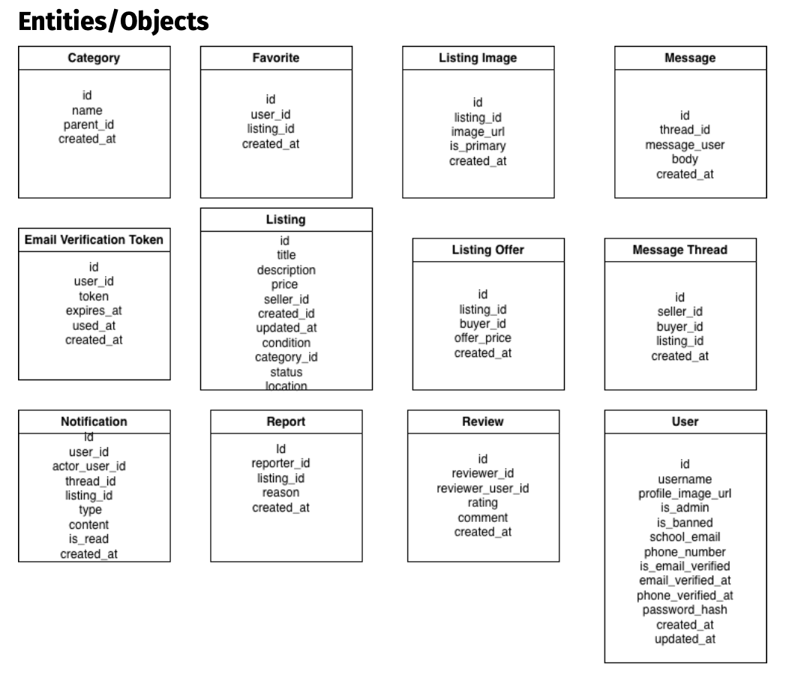

Slide 10
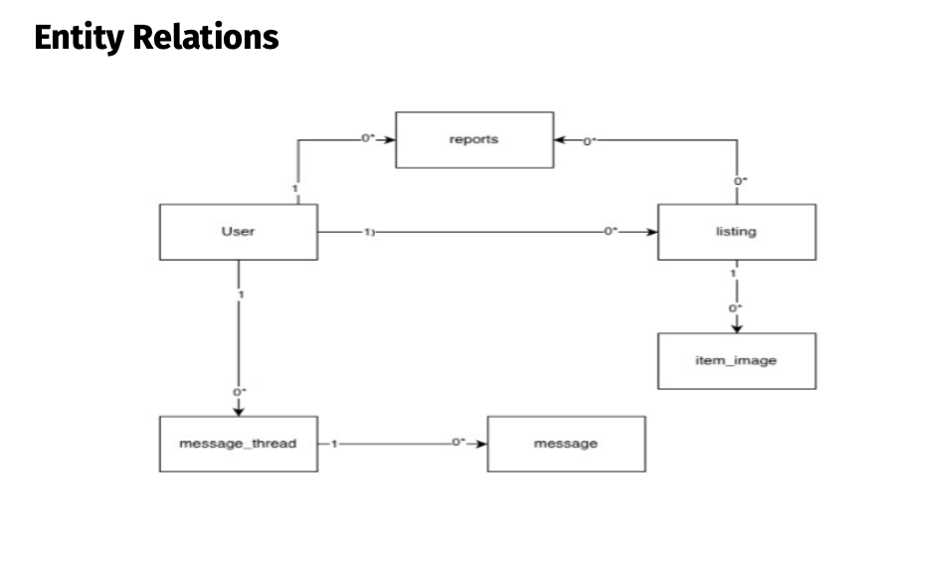

Slide 11
Team Workload
Eduardo Herrera-Barraza
• Document Maintainer
• Backend(First Iteration)
• Frontend(UI)
‣ User interactive views (splash Screen, login/signup,
profile settings)
‣ Admin interactive views
• Procurement of storage services
Lily Nguyen
• Document Co-Maintainer
• Marketing Strategy
• Backend(First Iteration)
• Frontend(UI)
‣ User and Hardware interactive View (Main Listings
page, More Info, and Listings Creator
Jared Martinez-Sanchez
• Backend(Major Revamp and Final Iteration)
• Frontend(UI)
‣ Interactive Messaging (API calls based Messaging)
‣ Major UI Cleanup
• Email Verification system setup

Slide 12
Problems We Faced
All of our first times doing mobile development
Having the app function efficiently – picture loading, account loading etc
Incorporating cloud-based services (Cloudflare and Render) to help manage deployment, storage and networking more efficiently

Slide 13
Related Coursework
Software Engineering (CSC 340)
Principles of Database Systems (CSC 471)
Data Structures and Algorithms (CSC 230 & 330)

Slide 14
App Features and Use Cases

Slide 15
App Features
Create a GenieMart account with email verification
Browse and search listings by category or keyword
Post items for sale with up to 8 photos
Built-in messaging between users
User profile management: edit listings, manage favorites, edit user info

Slide 16
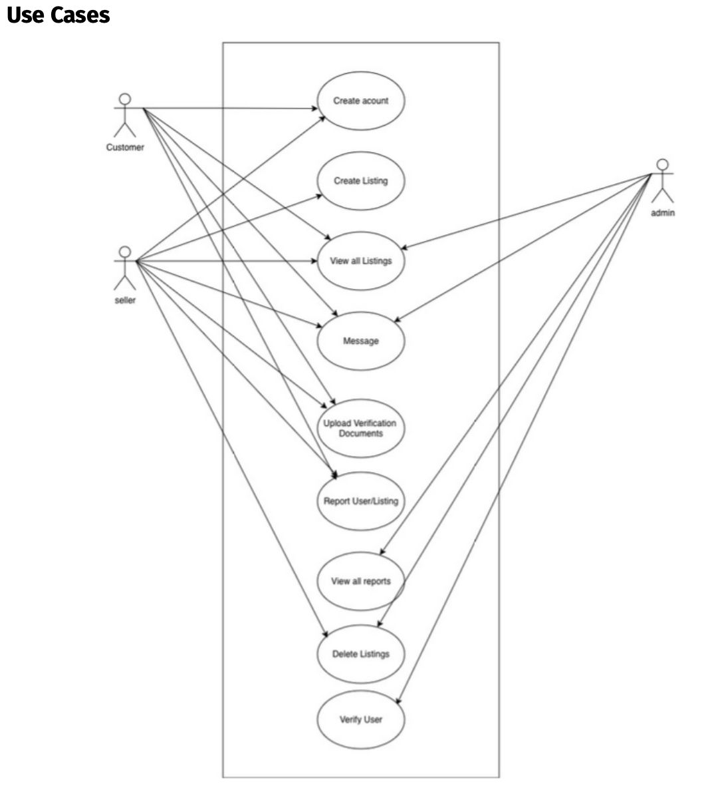

Slide 17
End Result and Future Plans
GenieMart is a fully functioning app where UNCG’s community can sign up using their email and safely post, communicate, exchange and interact with others of their community. Future plans and goals include integrating GoogleMapsAPI for a map of listings around campus and to incorporate payment features.

Slide 18
Thank You!
GenieMart Demo

